Slide 1
E-cigarette, or Vaping, Product Use-Associated Lung Injury (EVALI)
Ashley Haynes, MD , FACEP
March 6, 2020
SD ACEP

Slide 2
Disclosures
No financial conflicts to disclose

Slide 3
Objectives
1. Understand the basic presentation of E-vape associated lung injury
2. Discuss the proposed etiology of injury in EVALI
3. Identify criteria that suggest EVALI presentation

Slide 4
Case presentation
A 24 yo male presents with gradual onset of cough, dyspnea and subjective fevers
Vitals are significant for o2 saturation of 90% on RA, HR 100
He has no travel or known sick contacts
CXR shows bibasilar infiltrates
Endorses use of vaporized products previously

Slide 5
“Vaping”
The process of inhaling an aerosol created by heating a liquid or wax
Contain various substances:
Nicotine
Cannabinoids (eg, tetrahydrocannabinol, cannabidiol)
Flavoring
Additives (eg, glycerol, propylene glycol)

Slide 6
Electronic Nicotine Delivery System (ENDS)

Slide 7
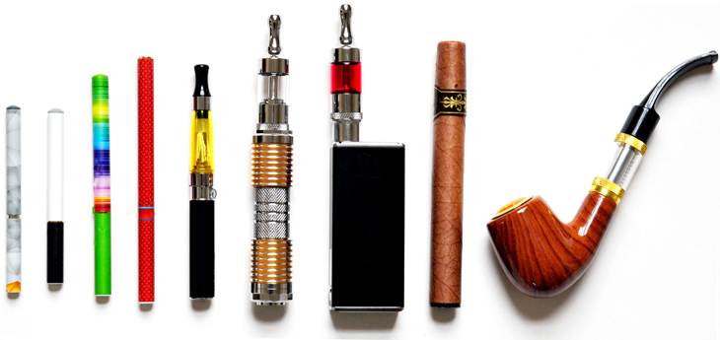

Slide 8
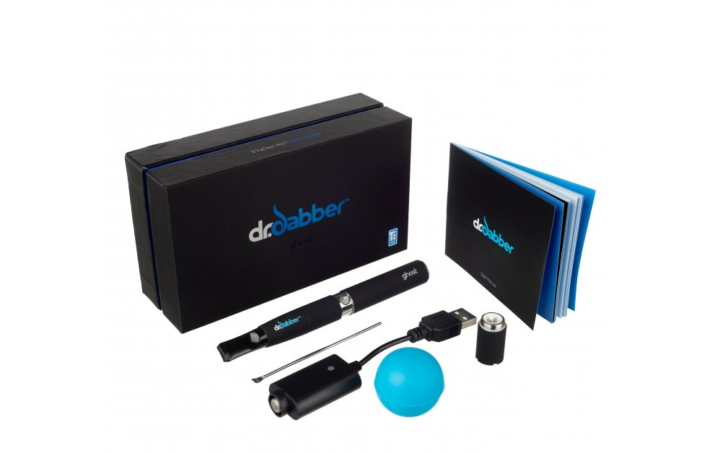

Slide 9
EVALI
First cases June 2019
Acute respiratory illness in patients with a history of e-cigarette/vaping and THC exposure
Negative infectious work up and poor response to treatment
Sharp increase in August 2019
CDC, FDA and state health agency investigations

Slide 10
Demographics
2807 cases reported to CDC as of Feb 18, 2020
68 deaths
66% male
75% under age 35 – median age 24
Peaked in September 2019, declining but continue to be new cases
Notes:
Age range 13-85
All 50 states, DC, PR, Virgin Islands
Reasons for the decline are likely multifactorial and may be related to the following:Increased public awareness of the risk associated with THC-containing e-cigarette, or vaping, product use as a result of the rapid public health response.
Removal of vitamin E acetate from some products.
Law enforcement actions related to illicit products.

Slide 11
Krishnasamy, et. al. Update: Characteristics of a Nationwide Outbreak of E-cigarette, or Vaping,Product Use–Associated Lung Injury — United States, August 2019–January 2020. MMWR. Jan 2020.

Slide 13
Clinical Presentation
Fever, cough, sore throat, shortness of breath, muscle aches, fatigue, nausea, or vomiting

Slide 14
Clinical Presentation
On physical examination, fever was present in 31 percent, tachycardia in 64 percent, and tachypnea in 43 percent
67 percent hypoxemic, with a pulse oxygen saturation ≤88 percent in 30 percent
Layden JE, Ghinai I, Pray I, et al. Pulmonary Illness Related to E-Cigarette Use in Illinois and Wisconsin - Preliminary Report. N Engl J Med 2019.
Progression to respiratory failure is common

Slide 15
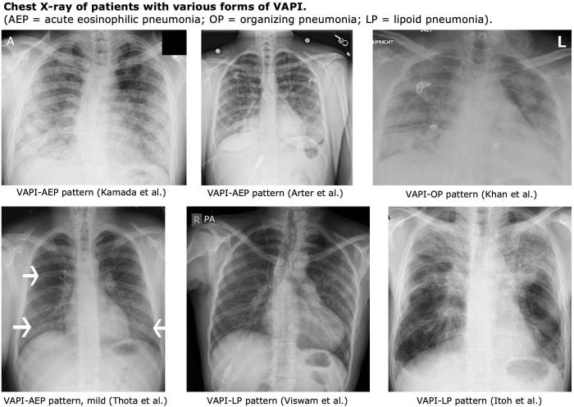
Imaging
Imaging – Nearly all will have chest imaging with diffuse hazy or consolidative opacities
91% + CXR, 100% abnormal with CT
Layden JE, Ghinai I, Pray I, et al. Pulmonary Illness Related to E-Cigarette Use in Illinois and Wisconsin - Preliminary Report. N Engl J Med 2019.
Basilar predominance of consolidative and ground glass opacities
Henry TS, Kanne JP, Kligerman SJ. Imaging of Vaping-Associated Lung Disease. N Engl J Med 2019; 381:1486.
EMCrit Project
Notes:
Labs targeted toward evaluation of differential diagnosis

Slide 16
Pathogenesis
Unknown
Possible spectrum of disease
Pathology:
Acute fibrinous pneumonitis, diffuse alveolar damage, or organizing pneumonia, usually bronchiolocentric and accompanied by bronchiolitis
Butt YM, Smith ML, Tazelaar HD, et al. Pathology of Vaping-Associated Lung Injury. N Engl J Med 2019; 381:1780.
Multinucleated giant cells that suggested a foreign body reaction to lipophilic material
Henry TS, Kanne JP, Kligerman SJ. Imaging of Vaping-Associated Lung Disease. N Engl J Med 2019; 381:1486.
Ring Madsen L, Vinther Krarup NH, Bergmann TK, et al. A Cancer That Went Up in Smoke: Pulmonary Reaction to e-Cigarettes Imitating Metastatic Cancer. Chest 2016; 149:e65.

Slide 17
Pathology
Individual reports:
acute eosinophilic pneumonia
Thota D, Latham E. Case report of electronic cigarettes possibly associated with eosinophilic pneumonitis in a previously healthy active-duty sailor. J Emerg Med 2014; 47:15.
diffuse alveolar hemorrhage
Agustin M, Yamamoto M, Cabrera F, Eusebio R. Diffuse Alveolar Hemorrhage Induced by Vaping. Case Rep Pulmonol 2018; 2018:9724530.
lipoid pneumonia
Davidson K, Brancato A, Heetderks P, et al. Outbreak of Electronic-Cigarette-Associated Acute Lipoid Pneumonia - North Carolina, July-August 2019. MMWR Morb Mortal Wkly Rep 2019; 68:784.
respiratory-bronchiolitis interstitial lung disease
Christiani DC. Vaping-Induced Lung Injury. N Engl J Med 2019.
Likely more than one mechanism of injury may be involved

Slide 18
Pathology
BAL fluid examination - THC or Vitamin E Acetate in the majority
Layden JE, Ghinai I, Pray I, et al. Pulmonary Illness Related to E-Cigarette Use in Illinois and Wisconsin - Preliminary Report. N Engl J Med 2019.
Schier JG, Meiman JG, Layden J, et al. Severe Pulmonary Disease Associated with Electronic-Cigarette-Product Use - Interim Guidance. MMWR Morb Mortal Wkly Rep 2019; 68:787.
Centers for Disease Control and Prevention. Outbreak of Lung Injury Associated with E-Cigarette Use, or Vaping. https://www.cdc.gov/tobacco/basic_information/e-cigarettes/severe-lung-disease.html (Accessed on October 20, 2019).
Butt YM, Smith ML, Tazelaar HD, et al. Pathology of Vaping-Associated Lung Injury. N Engl J Med 2019; 381:1780.
Christiani DC. Vaping-Induced Lung Injury. N Engl J Med 2019.
Ghinai I, Pray IW, Navon L, et al. E-cigarette Product Use, or Vaping, Among Persons with Associated Lung Injury - Illinois and Wisconsin, April-September 2019. MMWR Morb Mortal Wkly Rep 2019; 68:865.
Blount BC, Karwowski MP, Morel-Espinosa M, et al. Evaluation of Bronchoalveolar Lavage Fluid from Patients in an Outbreak of E-cigarette, or Vaping, Product Use-Associated Lung Injury - 10 States, August-October 2019. MMWR Morb Mortal Wkly Rep 2019; 68:1040.

Slide 19
Pathology
BAL fluid:
Variable cell counts
Tend to show an increase in neutrophils (65 percent with a range 10 to 91 percent)
Lipid laden-macrophages (eg, positive Oil-red-O stain)
Notes:
10% have had inc eosinophils
Lipid laden macrophages is nonspecific

Slide 20
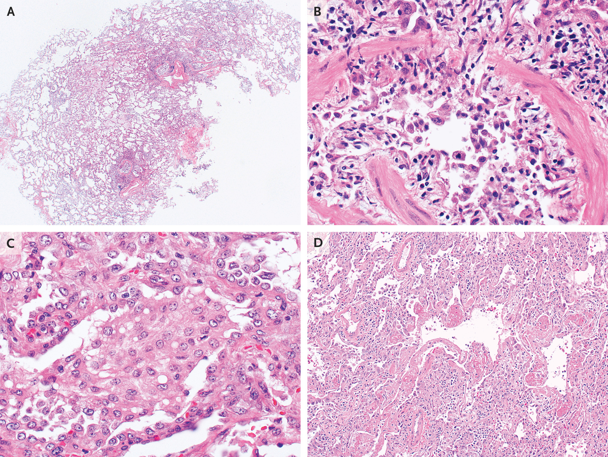
Butt et al. Pathology of Vaping-Associated Lung Injury. Letter to the Editor. NEJM. Oct. 2019
Notes:
Most cases showed airway-centered acute lung injury (Panel A), often with severe bronchiolitis accompanied by marked mucosal edema, sloughing of bronchiolar epithelium, and peribronchiolar organization (Panel B). All cases showed accumulation of foamy or vacuolated macrophages in peribronchiolar airspaces with pneumocyte vacuolization (Panel C). Four cases showed severe injury, with diffuse alveolar damage and hyaline membranes (Panel D); two of these patients died.

Slide 21
Marsden et al. More on the Pathology of Vaping Associated Lung Injury. NEJM. Jan 2020.
Notes:
The lungs showed diffuse alveolar damage with hyaline membranes, fibrinous exudate, and numerous intraalveolar macrophages (Panel A, hematoxylin and eosin). Reactive pneumocytes were present throughout the lungs, displaying atypia, multinucleation, and atypical mitoses (Panel B, hematoxylin and eosin). Alveolar macrophages were notable for the presence of refractile brown–black foreign material (Panel C, hematoxylin and eosin), as well as lipid (Panel D, oil red O).

Slide 22
Risk Factors
THC use 75-82% of cases
Product samples as high as 99% THC content
Vitamin E acetate on BAL (and product samples)
Nicotine products used in 35-58% of cases
Other suspected oils: CBD or other plant oils, medium chain triglycerides, petroleum distillates, terpenes
Have NOT been consistently found in BAL fluid or in product samples
Duffy, et al. Analysis of Cannabinoid-Containing Fluids in Illicit Vaping Cartridges Recovered from Pulmonary Injury Patients: Identification of Vitamin E Acetate as a Major Diluent. Toxics. Jan 2020.
Krishnasamy, et. al. Update: Characteristics of a Nationwide Outbreak of E-cigarette, or Vaping,Product Use–Associated Lung Injury — United States, August 2019–January 2020. MMWR. Jan 2020.

Slide 23
Risk Factors
Use of products obtained from illicit or informal (friends and family member) sources
Addition of homemade liquids to previously used cartridges or pods
Dripping the substance onto the heating element (called “dripping”)
Use of highly concentrated nicotine or THC prepared in a wax-like substance and vaporized in a pipe (called “dabbing”)
Some theory that the process of mixing and heating active and inactive components could lead to production of toxic new agents

Slide 24
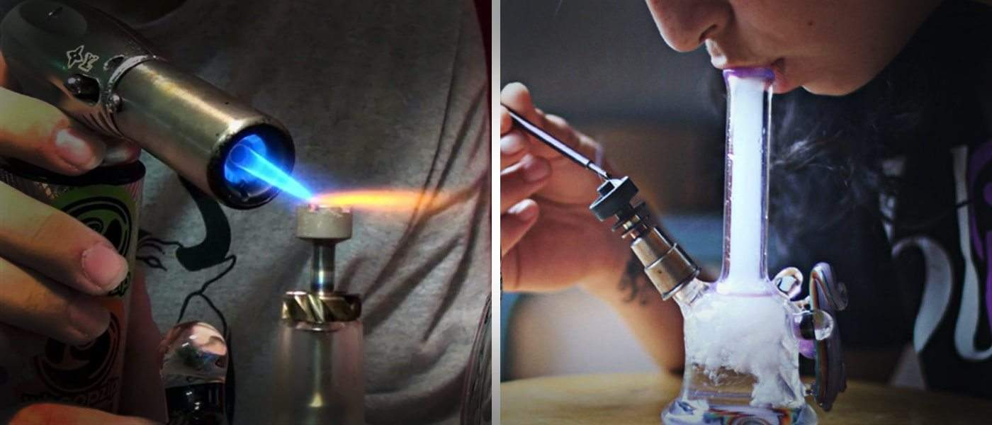
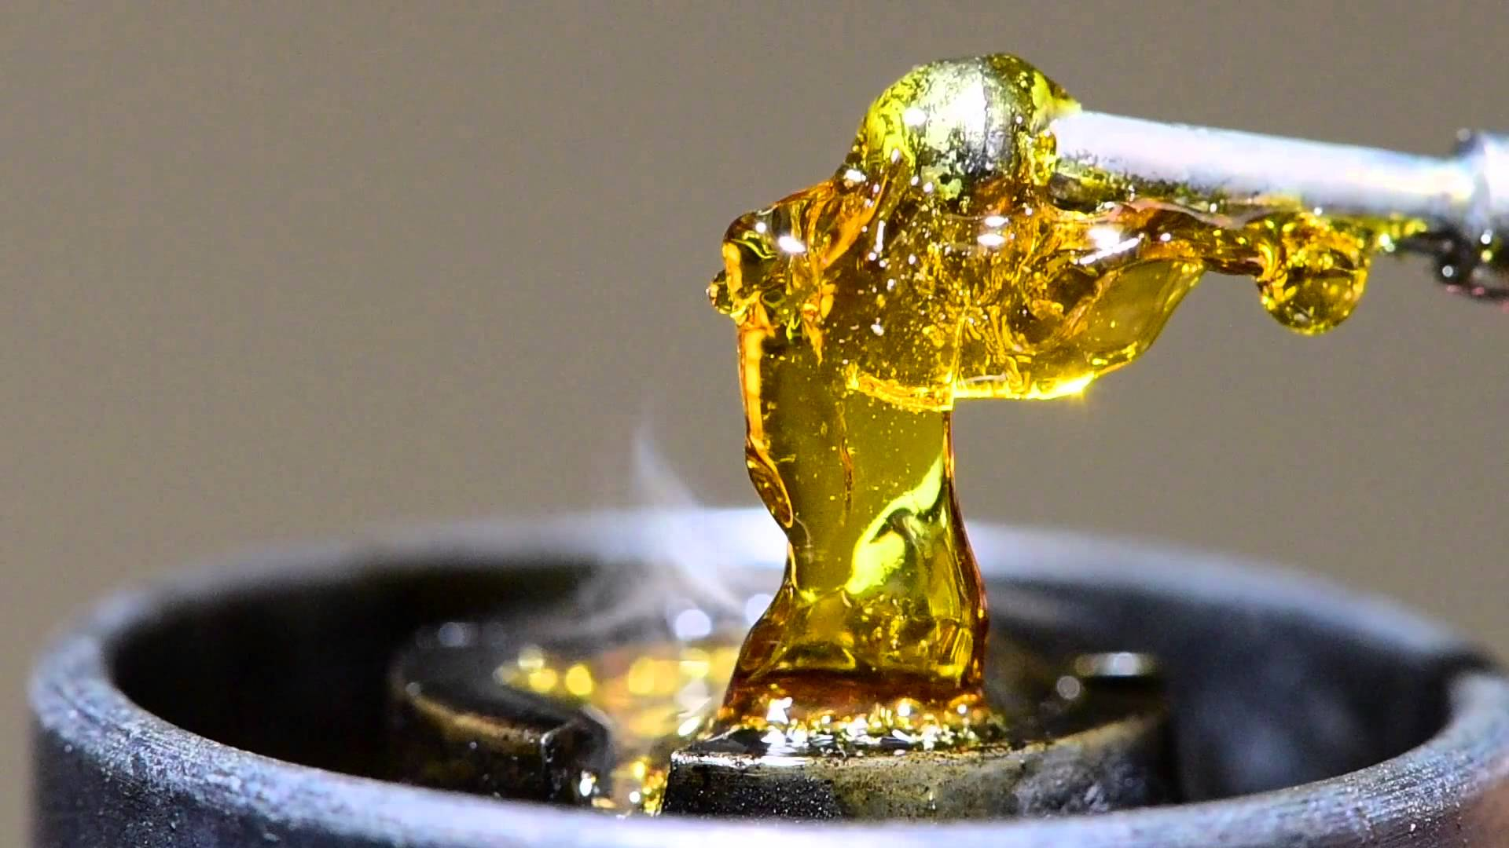
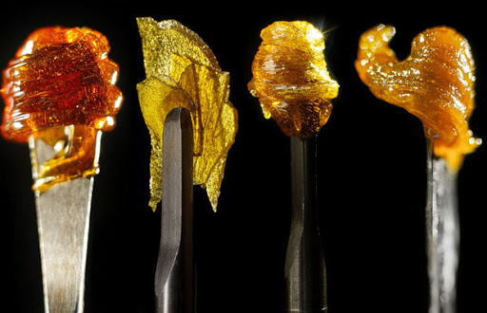

Slide 25
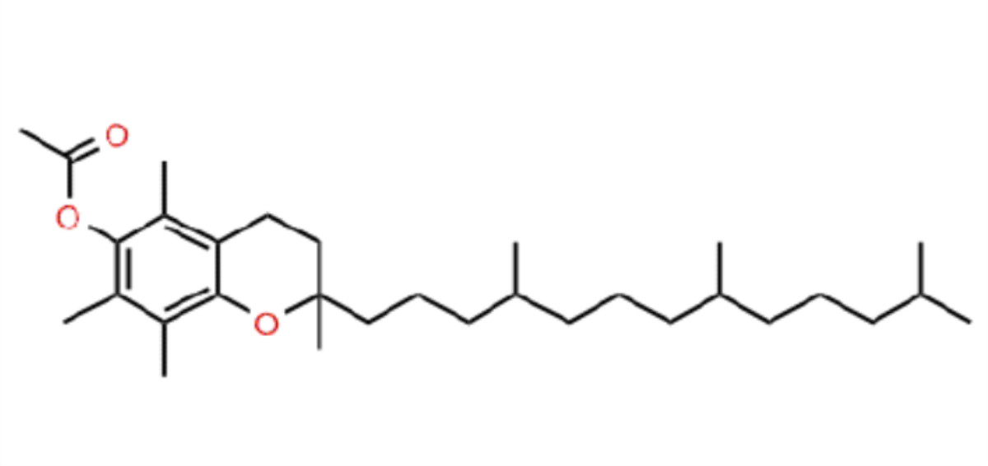
Vitamin E Acetate
Ester of vitamin E (α-tocopherol) and acetic acid
Long aliphatic tail - can penetrate a layer of surfactant to align the molecule in parallel with phospholipids
Phosphatidylcholines liquify
This disrupts surfactant ability to maintain surface tension
Blount, et. a.l. Vitamin E Acetate in Bronchoalveolar-Lavage Fluid Associated with EVALI. NEJM. Feb 2020.
Notes:
commonly used as a dietary supplement and in skin creams
safety of inhaling vitamin E acetate has received little attention

Slide 26
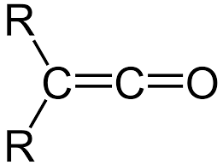
Vitamin E Acetate
Heating may create ketene by splitting off the acetate group from some or all of the vitamin E acetate
Ketene - reactive compound with potential as lung irritant
Blount, et. a.l. Vitamin E Acetate in Bronchoalveolar-Lavage Fluid Associated with EVALI. NEJM. Feb 2020.

Slide 27
Diagnosis
Diagnosis of exclusion
Suspect when:
+ history of vaping or other use of e-cigarette-related products
With: pneumonia-like syndrome, progressive dyspnea, and/or worsening hypoxemia
Notes:
What type(s) of vaping device were used (eg, bottle, cartridge, pod)?
●What products (eg, nicotine, tetrahydrocannabinol, cannabidiol, flavored liquid) were vaped?
●Were cartridges or pods reused? If so, were they filled with homemade, unlicensed, or commercially-licensed products?
●Was the product concentrated prior to use (eg, dabbing)?
●When did the patient start vaping relative to the onset of symptoms?
●How often was the patient vaping (eg, number of cartridges or pods per day, frequency of puffs)? Did they Valsalva at end-inhalation (thought to increase the rate of absorption)?
●Were they also smoking tobacco?
DDX: Community-acquired pneumonia (CAP); Acute eosinophilic pneumonia (AEP); Organizing Pneumonia; Lipoid pneumonia; Diffuse Alveolar Hemorrhage; Hypersensitivity Pneumonitis; Respiratory bronchiolitis interstitial lung disease (RBILD); Giant Cell Pneumonitis

Slide 28
CDC Case Definition
Use of an e-cigarette or related product in the previous 90 days
Lung opacities on chest radiograph or computed tomography (CT)
Exclusion of lung infection based on negative work-up
Absence of a likely alternative diagnosis
Notes:
influenza polymerase chain reaction (PCR) or rapid test (unless out of season), viral respiratory panel, and, as clinically indicated, urine antigen tests for Legionella and Streptococcus pneumoniae, blood cultures, sputum culture (if producing sputum), bronchoalveolar lavage (if performed), and testing for HIV-related opportunistic infections
Absence of: (eg, cardiac, neoplastic, rheumatologic)

Slide 29
Treatment
Supportive care
Rule out/treat CAP

Slide 30
Back to case
Patient started on empiric antibiotics
Sputum cultures sent
Flu PCR, Viral respiratory panel negative
Obtained additional information that patient using THC products he buys from a dealer on the street
He subsequently develops worsening hypoxemia and ultimately requires intubation
Any other considerations?

Slide 31
Treatment
Systemic glucocorticoids
Efficacy not yet studied, observational data
Not for all cases
If meet criteria for EVALI with progressively worsening symptoms and hypoxemia
Methylprednisolone 0.5 to 1 mg/kg per day and tapering over 5 to 10 days
Triantafyllou GA, Tiberio PJ, Zou RH, et al. Vaping-associated Acute Lung Injury: A Case Series. Am J Respir Crit Care Med 2019; 200:1430.
Notes:
Different presentations may respond differently to steroids
For patients with less severe presentations, it is reasonable to withhold initiation of glucocorticoids because of the greater likelihood of an infectious cause in patients with fever, dyspnea, and chest pain; the potential adverse effects of glucocorticoids; and the potential for resolution with supportive care.

Slide 32
Steroids Evidence
Case series of 53 patients, 46 (92 percent) received systemic glucocorticoids (83 percent intravenously)
Treating clinicians attributed clinical improvement to the glucocorticoids
Analysis of five patients, extubation from mechanical ventilation occurred 5 to 10 days after initiation of treatment with glucocorticoids
Exact dose of glucocorticoids was not provided, but the duration of therapy among the 46 treated patients was ≥7 days.
Layden JE, Ghinai I, Pray I, et al. Pulmonary Illness Related to E-Cigarette Use in Illinois and Wisconsin - Preliminary Report. N Engl J Med 2019.
Report of five patients, intravenous methylprednisolone 120 to 500 mg was administered daily
All five patients survived (one required mechanical ventilation; three required intensive care unit admission)
Clinical improvement was noted by 24 to 72 hours after initiation of methylprednisolone.
Davidson K, Brancato A, Heetderks P, et al. Outbreak of Electronic-Cigarette-Associated Acute Lipoid Pneumonia - North Carolina, July-August 2019. MMWR Morb Mortal Wkly Rep 2019; 68:784.

Slide 33
Steroids Evidence
Series of six patients
One patient developed progressive respiratory failure despite methylprednisolone (1 mg/kg) – ECMO initiated
Two patients managed with oxygen by nasal cannula did not receive systemic glucocorticoids and improved spontaneously
One patient had progressive respiratory insufficiency despite glucocorticoids, so therapy was discontinued, improved with supportive care.
Maddock SD, Cirulis MM, Callahan SJ, et al. Pulmonary Lipid-Laden Macrophages and Vaping. N Engl J Med 2019; 381:1488.

Slide 34
Disposition
Outpatient management: normal oxygen saturation, no respiratory distress, no pulmonary comorbidities, reliable access to care, strong social support systems,
Follow up within 24–48 hours of initial evaluation and to
Seek medical care promptly if respiratory symptoms worsen
Notes:
- in some cases, patients who initially had mild symptoms experienced a rapid worsening of symptoms within 48 hours

Slide 35
Disposition
Hospital management: concurrent illness (influenza) + potential EVALI, respiratory distress, comorbidities that compromise pulmonary reserve, or decreased oxygen saturation (≥95% while breathing room air)
13 of 1139 patients discharged after EVALI (2.7 percent) required rehospitalization and seven patients died
Typically older and had one or more underlying chronic condition
All of those who died after discharge had required mechanical ventilation
Rehospitalization at a median of four days after discharge and death at a median of three days.
Pulmonary follow-up within 2-4 weeks of discharge
Mikosz CA, Danielson M, Anderson KN, et al. Characteristics of Patients Experiencing Rehospitalization or Death After Hospital Discharge in a Nationwide Outbreak of E-cigarette, or Vaping, Product Use-Associated Lung Injury - United States, 2019. MMWR Morb Mortal Wkly Rep 2020; 68:1183.
Notes:
Longer-term pulmonary follow-up should generally occur within 2–4 weeks after discharge (often at completion of the corticosteroid taper) to assess pulmonary function and resolution of radiographic findings.
Discharge readiness checklist available on CDC website

Slide 36
Prognosis
68 deaths (2.4%)
1 transplant
Several needing home oxygen
Long-term outcomes unknown
Notes:
No other long-term data yet

Slide 37
Prevention
All should be counseled to avoid products of concern
CDC advises complete avoidance of THC-containing e-cigarettes or vaping products
Resumption of products may contribute to slowed improvement or recurrence
For the stubborn - Avoid unlicensed products
Notes:
Legally purchased products may still be harmful

Slide 38
Suspected Cases

Slide 39
Evans, et. Al. Update: Interim Guidance for Health Care Professionals Evaluating and Caring for Patients with Suspected E-cigarette, or Vaping, Product Use–Associated Lung Injury and for Reducing the Risk for Rehospitalization and Death Following Hospital Discharge — United States, December 2019. MMWR, December 2019.

Slide 40
Suspected Cases
ASK about vape products
Coordinate with local health department for reporting and possible additional testing
Save any residual products patient may have
Notes:
They may get intubated later

